Slide 1
Game Theory and Artificial Intelligence Design
Tad Cordle, Nolan Lum

Slide 2
Objectives
To design and develop an AI to play a game developed in-house.
To explore commonly used concepts and theories associated with game theory.
To become familiarized with best practices and common procedures used with source control systems.

Slide 3
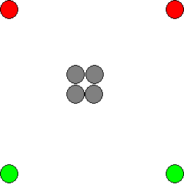
Overview – Blob Wars
The game starts with 2 player-controlled pieces per player.
Grey spaces are immovable and neutral.

Slide 4
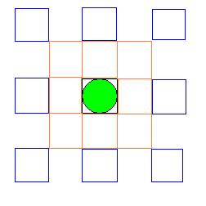
Overview – Blob Wars
Each piece can move to the 8 spaces adjacent, cloning the piece.
It can also jump 2 spaces, but this consumes the original piece.

Slide 5
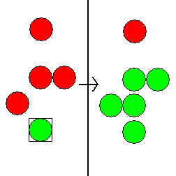
Overview – Blob Wars
Landing a player-controlled piece next to opponent pieces converts the pieces adjacent.
Note that only the pieces in the 8 spaces adjacent to the piece are converted.

Slide 6
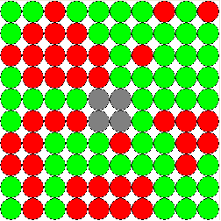
Overview – Blob Wars
The game ends when the board is completely full.
Or, when one player has no moves available.

Slide 7
Important “GamePiece” Class Properties
Class representing a game piece
Properties
Code – returns the type of piece it is and specifies which image to draw on the board
Selected – whether or not the piece is selected by the player
x and y – specify the piece’s position
MoveIsInRange(int xto, int yto)
Returns true if the board position (xto, yto) is within moving range

Slide 8
Important “Board” Class Properties
Class representing a game board
Properties
SIZE_X and SIZE_Y – Constants that represent the size of the game board
GamePiece[][] board – Matrix of game pieces
int[] counts – Keeps track of the number of each type of piece (including empty spaces) on the board
GameOver – Is set to true when there are no empty spaces left or when a player has no moves left

Slide 9
“Board” Class Cont.
Constructors
Load in initial board state from text files
Allows for different kinds of boards to be played on
Index operator this[,] and GetPieceAtPosition(x, y)
Allow for easy access of board contents
Convert (x, y, c1, c2)
Converts all adjacent piece to position (x, y) with code c2 to a piece with code c1
HasMovesLeft(c)
Checks each piece of code c and sees if there is an empty space that can be moved to. If not, return false

Slide 10
“Board” Class Cont.
FillEmptySpaces and DuplicatePiece
Uses recursion to fill all spaces that can be moved to by the specified code with pieces of that code
Used at the end of a game when a player can’t move but another still can
SpaceInBounds(x1, y1, x2, y2)
Returns whether or not the space (x1 + x2, y1 + y2) is still inside the board to avoid IndexOutOfBounds exceptions

Slide 11
The Blob Wars UI
Boolean value for playerTurn is used to keep track of whose turn it is
Picture box used to display game board
When picture box is left clicked, the mouse coordinates are converted to matrix positions to find out which piece to select (black box drawn around Board.SelectedPiece)
When right clicked, the selected piece is moved (if moveable), conversions are made, and the board is updated
If Human vs Human game type, playerTurn = !playerTurn, otherwise, AI is run
Game over status is checked for whenever a turn ends

Slide 12
The Blob Wars UI Cont.
AI is run in a seperate thread
Threads are used to run multiple sections of code pseudo-simultaneously
AI is run on its own thread so the user can interact with the interface while the AI is “thinking”
AI vs AI
It is also possible to run two AI’s against eachother
In AI vs AI game, the AI moves until the game ends or a new game is chose
while (!endgame && type == GameType.AIvsAI)
{
DoAI(c);
c = (c == 1 ? 2 : 1);
}

Slide 13
The Blob Wars UI Cont.
DoAI(int code)
Begins AI move execution
while (!aiMoveComplete.WaitOne(10))
Application.DoEvents();
Updates form normally while AI is running
Once loop is broken, end game status is checked

Slide 14
Designing the Artificial Intelligence (AI)
Several problems needed to be solved in the design of the AI:
Ranking and categorization of possible moves.
Move search algorithm.
Ranking and categorization of board states.
Moves are explored in a tree-like structure, utilizing a modified depth-first search.

Slide 15
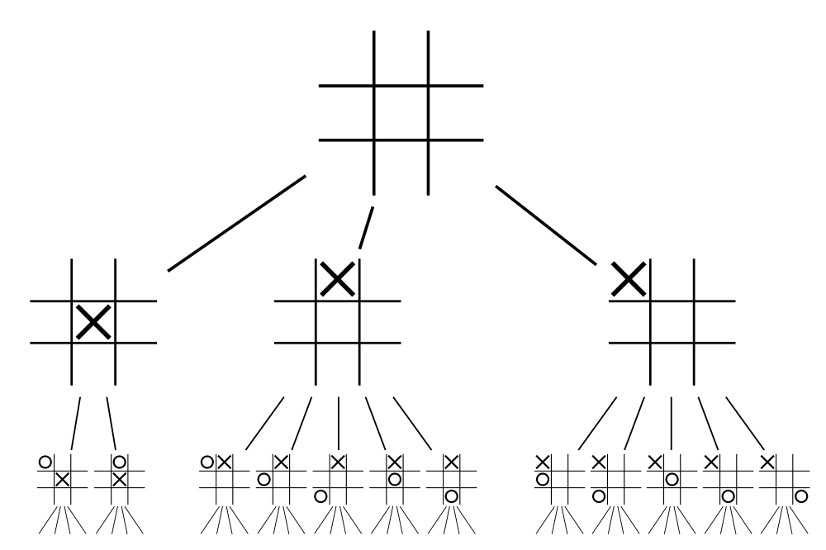
Designing the AI
Exploring the game tree:
Each node is a possible state.
Each branch represents a move.
Each complete level is a “ply”.
Depth First Search
Moves are searched up to a certain “depth”, then exploration proceeds sideways.
An example game tree for tic-tac-toe.

Slide 16
Choosing Moves – The Minimax Algorithm
Minimax is a type of decision making in which the player’s gain is maximized while the player’s loss is simultaneously minimized
The decision tree is explored and each available move is considered
Each maximizing player node takes the highest value of its children nodes as its value
Similarly, each minimizing player node will take the lowest value of its children

Slide 17
Minimax Overview
-Black circles will represent
the AI (aiming for highest
score) and white circles will
represent the opponent (wants
to minimize the player’s score)
-Maximizing nodes simply take
the highest value of its children
-Minimizing nodes take the
lowest value
-The values of the bottom nodes
are the heuristic value of the
board state that each of those
nodes represent
7
7
4
2
7
9
4
2
5
4
7
1
9
4
3
1
2
5
Therefore, black nodes will choose the highest values and white nodes will choose the lowest

Slide 18
Minimax Overview Cont.
Once all of the values of the tree are covered, the AI will execute whichever move leads to the highest score
In the case of our tree, the AI will choose the move that leads to the immediate score of 7 because that is the highest calculated score
7
7
4
2

Slide 19
Minimax pseudocode
int minimax(Node node, int currentDepth)
{
if (currentDepth <= 0 or game over at node)
return heuristic value of node
int a = -infinity
foreach child in node
a = max (a, -minimax(child, currentDepth – 1))
return a
}

Slide 20
Problems with Minimax
Minimax requires total search of decision tree
With games like blob wars, it would take an extremely long time to search every possible move at even low search depths
Each piece can have up to 16 possible moves
With an 8x8 game board (about 64 spaces), millions of nodes could be generated at just a search depth of 4

Slide 21
Alpha-Beta Pruning
An optomized form of mini-max
Avoids searching through unnecessary nodes
When searching through the game tree, if a value is found that is worse than the best value the minimizing opponent can choose for you, you can stop searching through that node because you know that no better score will be generated from that node
That makes no sense but it’s okay

Slide 22
Alpha-Beta Overview
-Here is a new tree (this
time, however, the entire
tree will not be searched)
-Two values are used to
keep track of the scoring
bounds of our search:
Alpha (a) and
Beta (B), which are
initially set to infinity and
–infinity, respectively
3
8
2
5
7
9
0
2
5
3
2
6
Alpha is the maximum lower bound of possible solutions
Beta is the minimum upper bound of possible solutions

Slide 23
Alpha-Beta Overview
The first value hit is a 3.
Since this is the child of a minimizing node, we know that the minimax value of this node must be less than or equal to 3. We set the beta of its parent node to 3.
The next child is greater than the beta value, which means it is higher than the current min value. This new node is ignored
3
B=3
3
8
All children have been searched, so the value of the minimizing node is set to the beta value

Slide 24
Alpha-Beta Overview
So far, the higest value the max node can achieve is 3, so we set a to 3. The rest of max’s children are searched and the alpha value is passed down
a=3
3
B=3
3
a=3
3
B=3
The value is 2. From just this node, we know that the minimizing player will achieve a value of AT MOST 2. However, our alpha value is 3, which means the max player already has found move that returns a higher score than what this node can provide. This means we already know we don’t have to search this node anymore.
a=3
a=7
a=3
3
B=3
7
3
a=3
a=3
3
2
B=2
7
The max node’s
children have all
been searched, so
we set the value of
the max node to a
a=3
B=2
2
3
B=3
B=3
B=3
3
8
2
7
2
3

Slide 25
Alpha-Beta Overview Cont.
This pattern continues, passing alpha (max) and beta (min) values between nodes in order to eliminate unnecessary searching
This drastically improves the run time of the program

Slide 26
Comparison
Without pruning
With pruning

Slide 27
Alpha-Beta Pruning Pseudocode
int AlphaBeta(int depth, int alpha, int beta)
{
if (depth == 0)
return Evaluate();
GenerateLegalMoves();
while (MovesLeft()) {
MakeNextMove();
val = -AlphaBeta(depth - 1, -beta, -alpha);
UnmakeMove();
if (val >= beta)
return beta;
if (val > alpha)
alpha = val;
}
return alpha;
}

Slide 28
Alpha Beta in Blob Wars
Very similar to the pseudo code, but when an alpha value is stored, the move is saved in a list and the value is stored in a variable in each node
Senior Project\AI3.cs

Slide 29
Optomizations – Transposition Tables
Transposition tables are hash sets that are used to avoid repetition (or use it to our advantage)
Sometimes multiple move sequences may lead to the same board state
This means the same result could be found multiple times
If a board state is found that is already in the transposition table, it can be ignored
Otherwise, add the board state to the transposition table

Slide 30
Transposition Tables Cont.
Instead of using a Hash Set, our AI uses a Dictionary for easy indexing
If a transposition is found and has already been scored, use the existing score and stop searching
Further reduces search time

Slide 31
Optomizations - Repetition Check
Similar to transposition tables but only used to avoid multiple of the same single-depth move
For example:
Different moves can lead to the same board state
In Blob Wars, in the diagram above, the piece on the left and the piece on the right can each duplicate to the middle space
By adding each scenario to a Hash Set, repetitive moves are eliminated and the search tree is made even smaller

Slide 32
Optomizations - Undoing Simulated Moves
Creating a new board for every node in the game tree is inefficient
Instead, we use a stack of structures made up of move information (such as starting position, ending position, whether or not it was a jump etc.) to keep track of the moves executed on a single working board
Every time a board state is evaluated, the stack is popped and the move that lead to that board is executed in reverse, which leads back to the original board state

Slide 33
Optomizations – The “AIBoard” Class
Still, searching through every space on every board to check for whether or not the pieces can make conversions or moves is time costly
Alternative is to represent the board as an array of unsigned 64 bit integers (ulongs)
The board is 8x8 spaces, so each bit represents a space, where a 1 means the space is occupied and a 0 means it is not
Array of size 4, so each ulong represents pieces of each type

Slide 34
The “AIBoard” Class Cont.
Indexing
Since ulong is 1-dimensional, every 8 bits represents a row on the board
First 8 = first row, second 8 = 2nd row, etc.
Board piece at index[x, y] = ulong[y * 8 + x]
Masking
Several “masks” are created so that when the AND operator is applied to the mask and the board, the result represents certain properties
An array of each mask of size 64 is created (represents each mask at each position on the board)

Slide 35
The “AIBoard” Class Cont.
Several masks were used to check for certain scenarios for each piece
Perimeter mask
A ulong with a specific value so that it has a 1 at the index above, below, and to the left and right of the current masking position
Conversion mask
Much like the perimeter mask but has a 1 at the diagonal adjacent spots as well

Slide 36
The “AIBoard” Class Cont.
Movement mask
Has a 1 at all positions that correspond to a spot that the piece can move to
Vulnerability mask
Has a 1 at all positions that an enemy piece could be located in relative to the friendly piece such that the friendly piece could be converted by the enemy piece in the next move

Slide 37
Visualizing the Masking
With the AND operator (&), we can check whether or not there are free spaces, vulnerabilities etc.
With this example, we apply the conversion mask to the green 0 on this enemy board to simulate the conversions if a friendly piece moved to that position
1 0 1 1 0 1 1 1
1 1 0 0 0 0 0 0
1 0 0 0 0 0 0 0
1 0 1 1 1 0 0 0
0 0 0 0 0 0 0 0
0 0 0 0 1 0 0 0
1 0 0 0 1 1 0 0
0 1 0 1 0 0 0 0
1 1 0 0 0
0 0 0 0 0
0 1 0 0 0
0 1 1 0 0
1 0 0 0 0
0 0 0 0 0
0 0 0 0 0
0 1 0 0 0
0 1 1 0 0
0 0 0 0 0
0 0 0 0 0
0 1 1 1 0
0 1 0 1 0
0 1 1 1 0
0 0 0 0 0
&

Slide 38
Visualizing the Masking Cont.
Notice that there are three 1’s that remain on the board
In the program, we find the hamming weight (or pop count) of the result of the operation to find the number of 1’s that remain
This means that if a friendly piece were to move to that position, it would convert 3 enemy pieces
All this is done in a single operation, instead of having to search every space around each piece
HUGE time saver

Slide 39
The Evaluation Function
Used to find the heuristic value of a board state
End game
If a board state is an end game state we return:
int.Max() if it is a win
int.Min() if it is a loss
This way, no matter what, the AI will aim for a win and avoid a loss at all costs

Slide 40
The Evaluation Function Cont.
There are 3 properties to take into consideration in Blob Wars when evaluating a board
The friendly piece count (simply board.Count(code))
The number of friendly pieces that are vulnerable to enemy pieces
The total perimeter of the shape that the friendly pieces form on the board
We simply use the masking technique to count the perimeter and vulnerability
Return a combination of each of these properties (weighing them differently) as the final score
Ended up being 25*piececount – 8*vulnpieces – 2*perimeter

Slide 41
Dynamic Compilation
It is also possible to compile C# files at run time using CSharpCodeProvider
Therefore, we added the option to run AI against AI
It is possible to browse C# files, load them in, and run them if they extend “AI” (as long as they have a MakeMove() method)
Sandboxing and security are used to make sure the newly compiled code will do no harm to the user’s computer

Slide 42
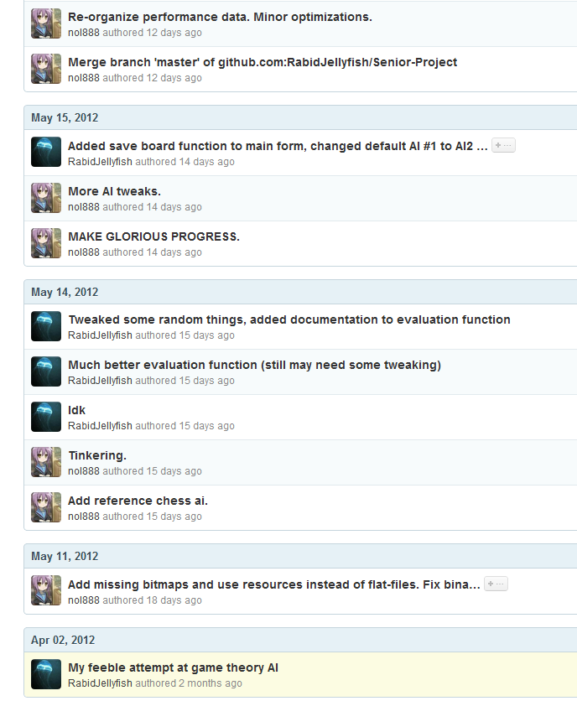
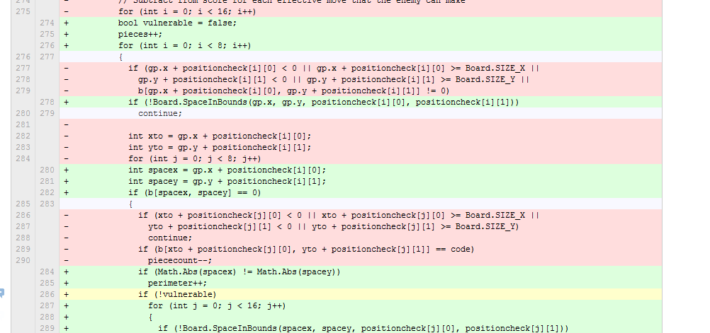
Source Control
Used Git to upload and download progress on project
Able to keep track of eachother’s changes on GitHub

